Slide 1
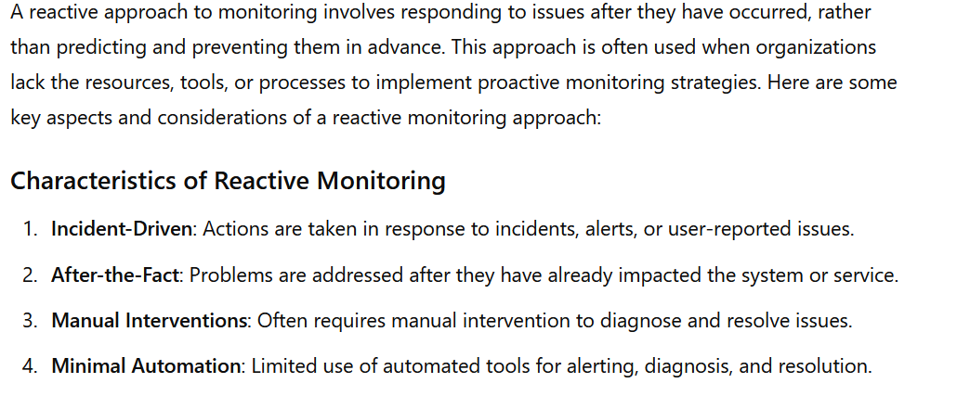
Reactive approach of monitoring

Slide 2
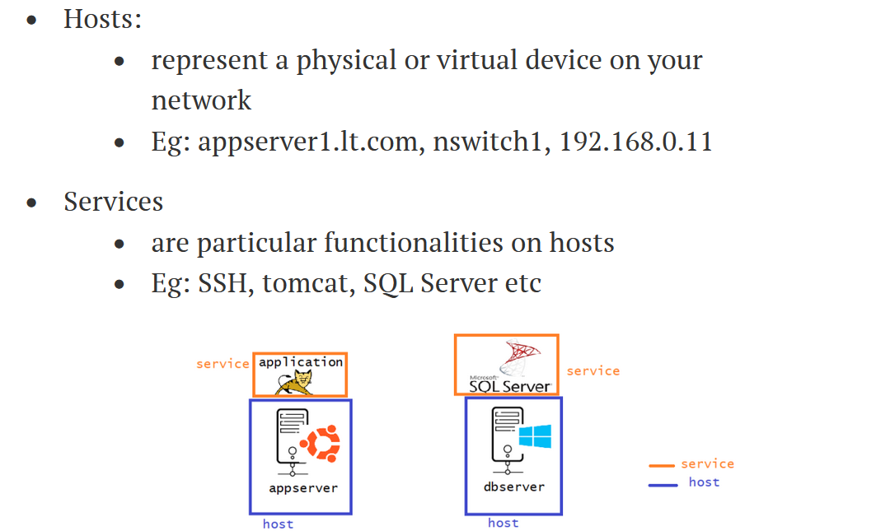
Categories of objects

Slide 3
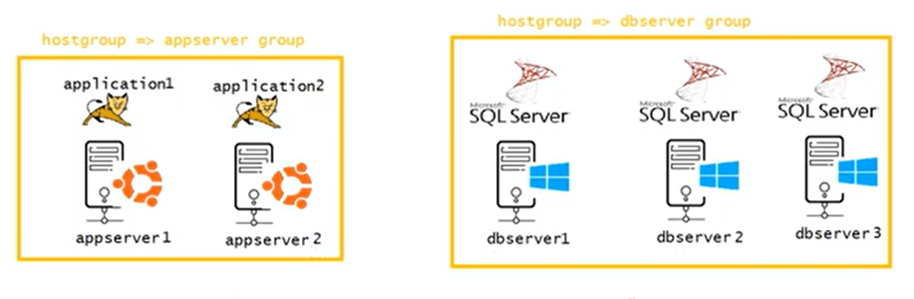
Grouping server

Slide 4
Monitoring planning
What you want to monitor
How frequently you want to monitor
How to create automated ticket
Alert priority
Notification group and mail
Information that needs to share

Slide 5
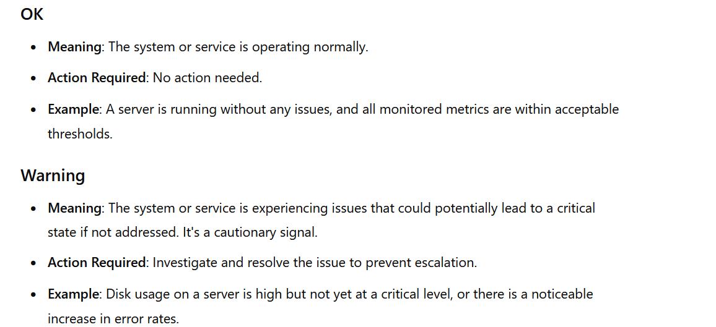

Slide 6
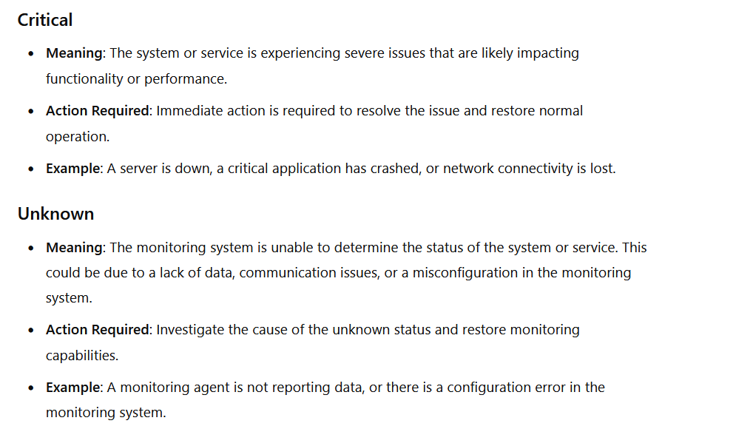

Slide 7
